Slide 1
Understanding Student behavior and Performance
Exploring the impact of Behavior on Academic Success.
By : Amal Assem

Slide 2
Introduction
Student Performance & Behavior Dataset is designed to facilitate the analysis of various factors influencing student performance and behavior, enabling educators and researchers to develop strategies for academic improvement and behavioral interventions

Slide 3
Student Behavior and Performance Analysis
Student Behavior: Refers to actions and attitudes displayed by students in a learning environment.
Student Performance: Measured by academic achievements, including grades, participation, and skill development.
Why It Matters: Understanding behavior helps in identifying at-risk students and improving learning outcomes.

Slide 4
Data Preprocessing:
o
Loaded the dataset into a Pandas Data Frame.
Dropped irrelevant columns (Student ID, names and, email)
Analyzed categorical and numerical features
Understand data characteristics and potential issues.

Slide 5
Handling Missing Values:
Numerical Columns :
Categorical Columns:
Identified a high percentage of missing values (35.88%) in the 'Parent_Education_Level' column.
Due to the low correlation with other features, the column was dropped to avoid introducing bias through imputation.
Analyzed correlation and distributions of 'Attendance (%)' and 'Assignments_Avg' columns, which contained missing values.
Applied Regression Imputation to estimate missing values for 'Attendance (%)'.
Applied Random Imputation for 'Assignments_Avg'.

Slide 6
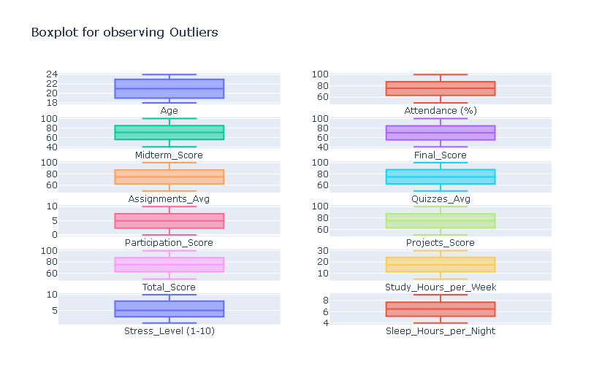
Outlier Detection and Handling:
Used box plots to visually identify potential outliers in numerical features.
Employed the IQR method to detect and replace numerical outliers with reasonable values.
Applied the threshold method to address rare categorical values, ensuring that categorical outliers were replaced with the mode

Slide 7
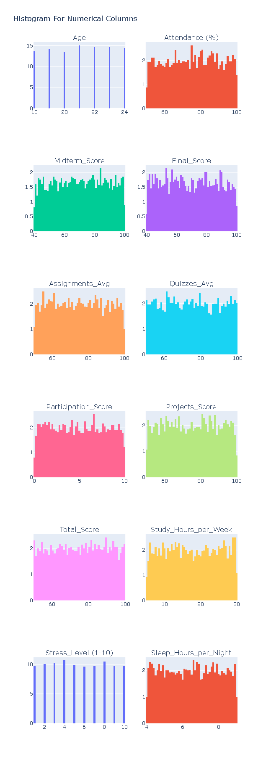
Assessed data skewness
Using histograms and KDE plots for numerical features.

Slide 8
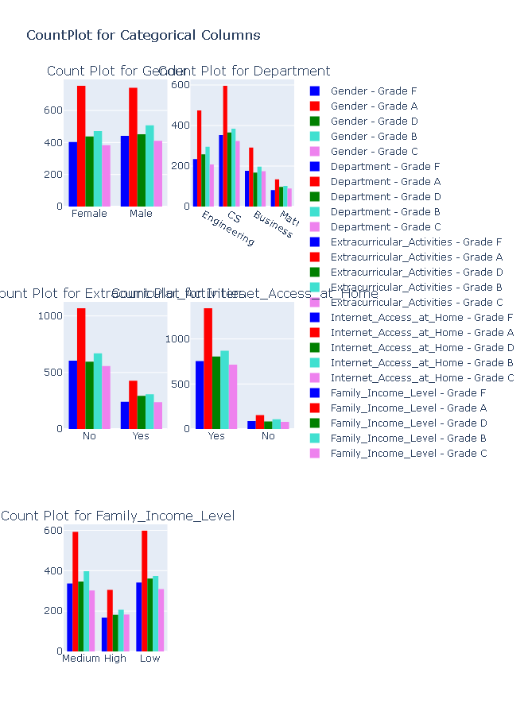
count plots to analyze categorical features and their relationship with grades.
Gender might not be a major factor significantly impacting grades. we also noticed that this column contain un logical values
. The distribution of grades varies across departments.
Most students across all grades have internet access at home, with a relatively small number who do not.

Slide 9
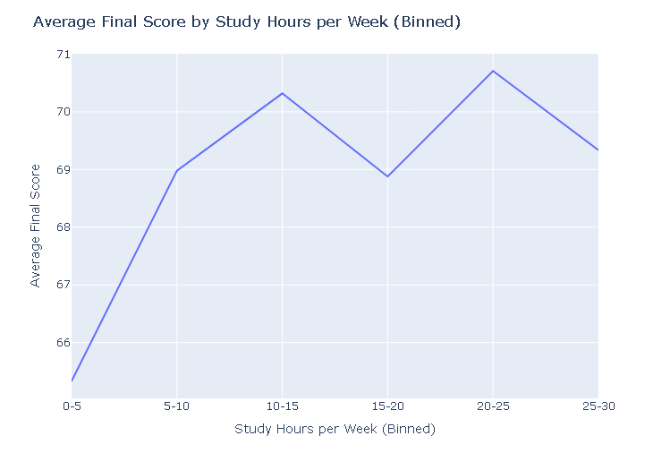
Average Total Score by Study Hours
Positive Trend: The line generally slopes upward from left to right, indicating a positive relationship between study hours and final scores. This supports the common understanding that more study time leads to better academic outcomes.

Slide 10
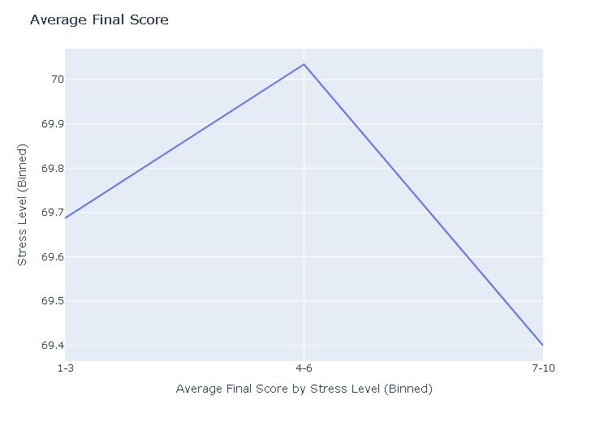
Average Final Score by Stress _Level
Negative Trend: The line generally slopes downward from left to right, indicating a negative relationship between stress levels and final scores. This supports the understanding that stress can hinder learning and cognitive function, leading to lower academic outcomes.

Slide 11
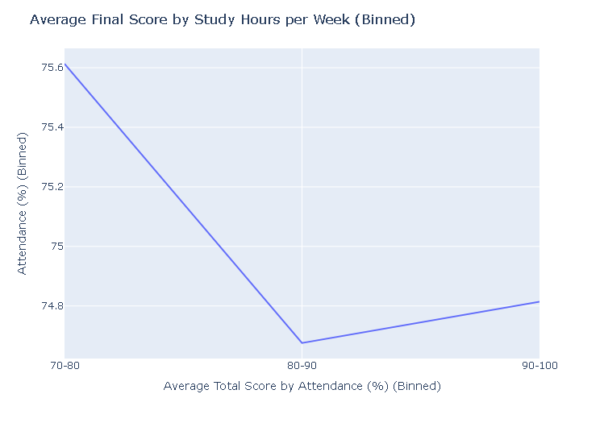
Average Total Score by Attendance (%)
It doesn't show a purely positive correlation throughout the entire range of attendance. It appears to have a negative relationship initially, then transitions to a positive relationship around the 80-90% attendance bin.

Slide 12
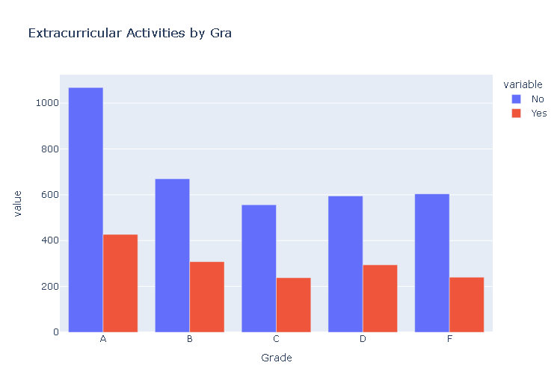
Bar Plot Extra Activities by Grade
The plot might reveal a trend where students achieving higher grades (A, B) have a lower participation rate in extracurricular activities compared to students with lower grades (C, D, F).

Slide 13
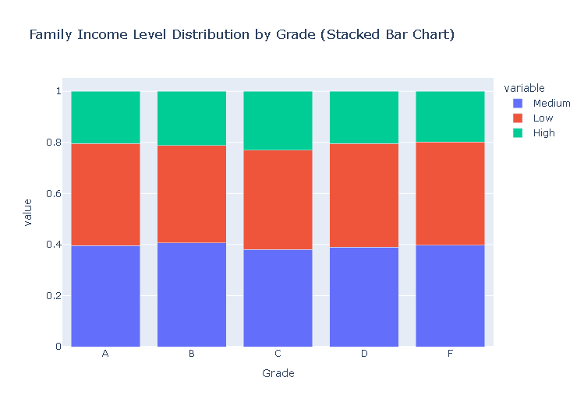
Stack Bar Chart : Family Income Level by Grade
This trend suggests that socioeconomic background may play a role in academic achievement. Students from higher-income families might have access to more resources and support systems, which can positively impact their grades.

Slide 14
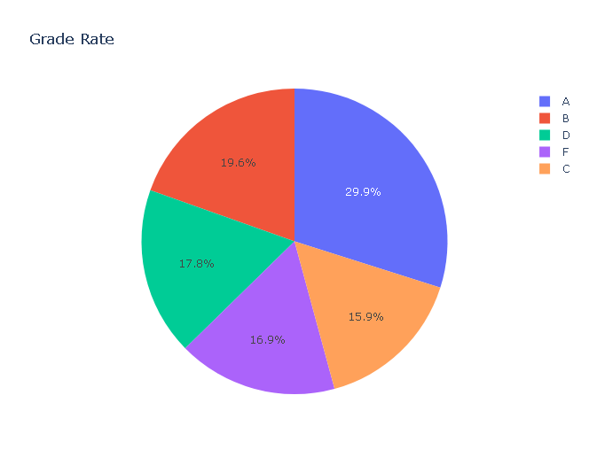
Grade Column (Target Column)

Slide 15
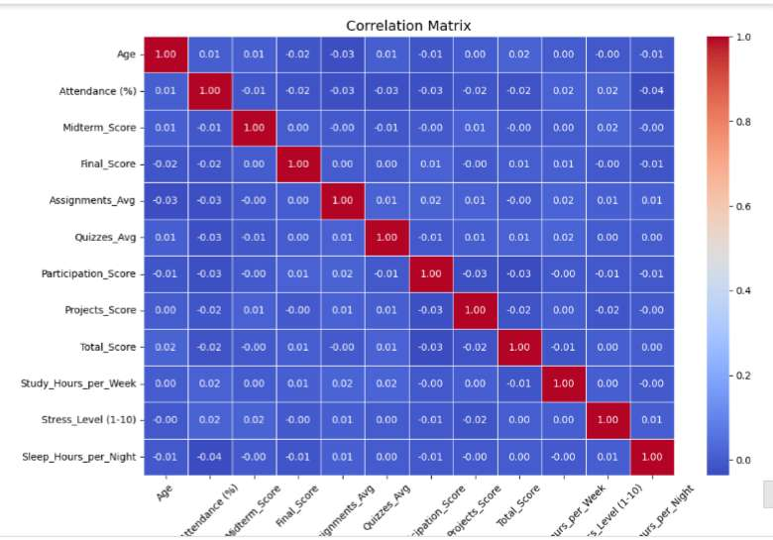
Correlation Matrix

Slide 16
Conclusion
The analysis of the Student Performance & Behavior Dataset provides valuable insights into factors affecting student success. Key findings suggest that attendance, consistency in assignments, and efficient study habits are crucial for academic performance. Stress levels appear to have a negative impact, highlighting the need for student support in this area. Socioeconomic background also seems to influence academic outcomes. By understanding these trends, institutions can make informed decisions to improve teaching strategies, allocate resources effectively, and foster an environment that supports student growth and achievement.

